Slide 1

Roman Starts in the Nelson Lab
Jonathan Nelson Welcome
6.17.25

Slide 2
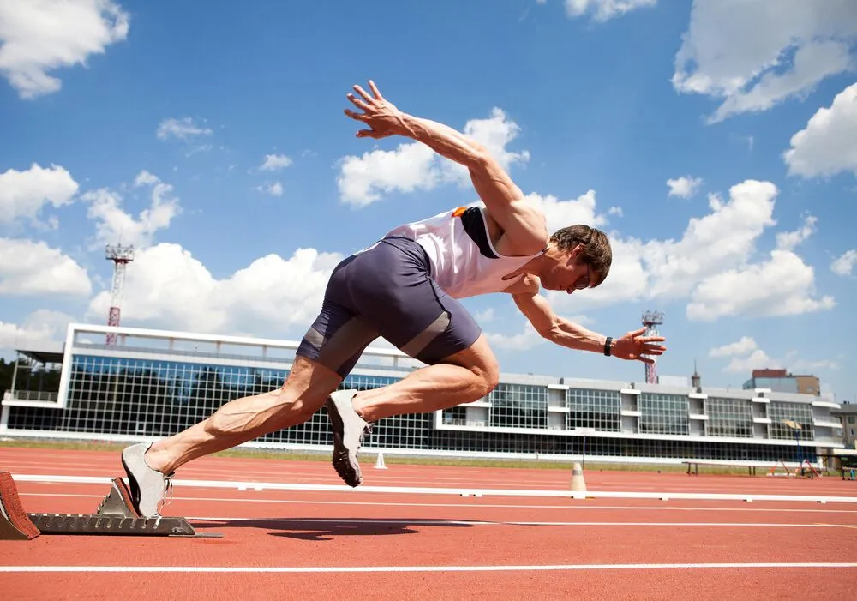
This is a Sprint!

Slide 3

Sometimes You Might Feel Like Your Downing

Slide 4
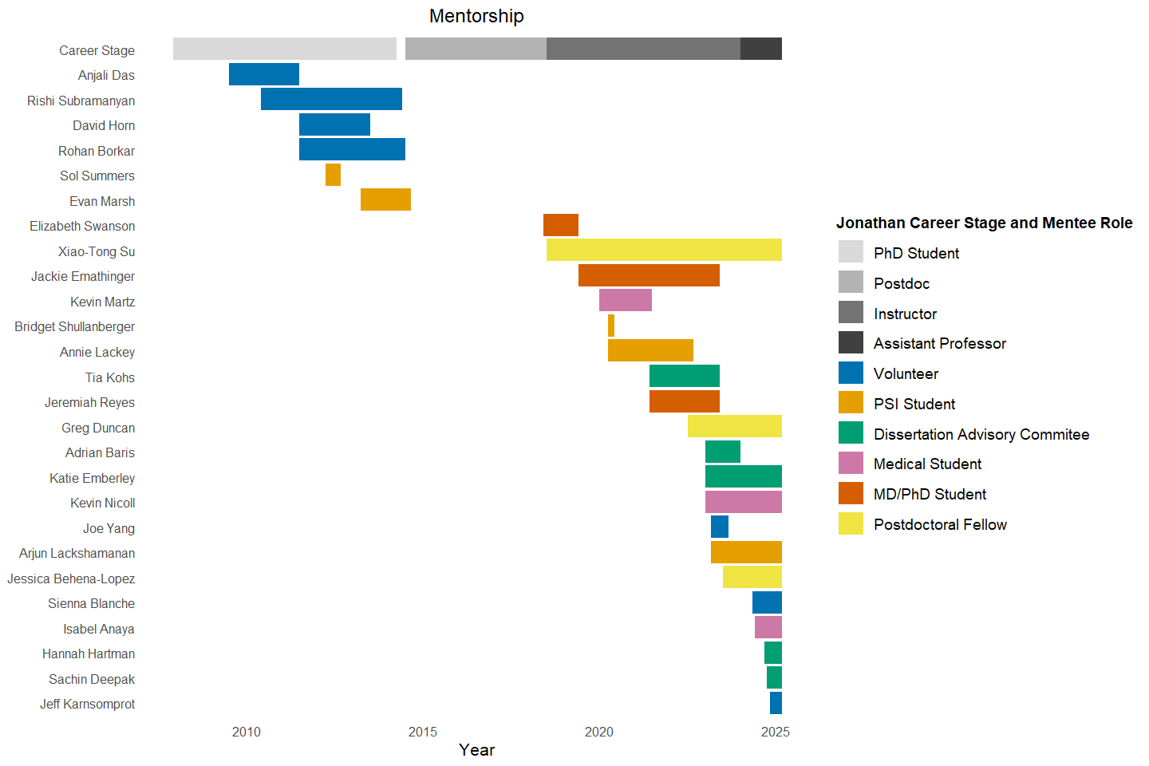
Trust Me
We’ll add you to this graph after this meeting

Slide 5
Give Me Your 100%

Slide 6

Think Of What You Want 7 Weeks From Now

Slide 7

How Are We Going To Measure Success?

Slide 8
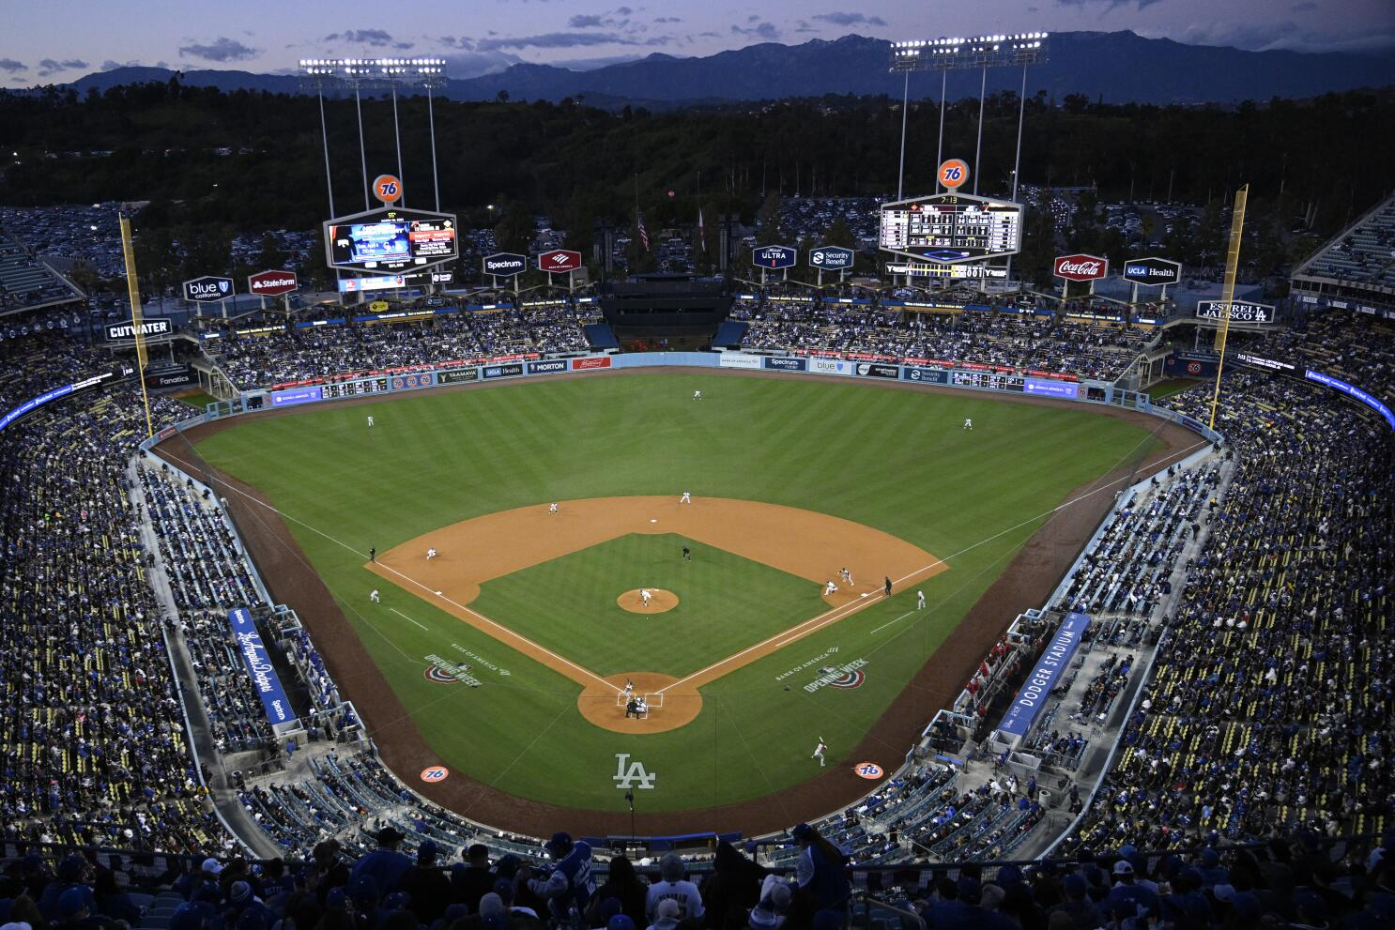
The Arena of Science!
Roman

Slide 9
The Arena of Science!
Roman
Your IN the Arena now!

Slide 10
Think of me like a team mate

Slide 11
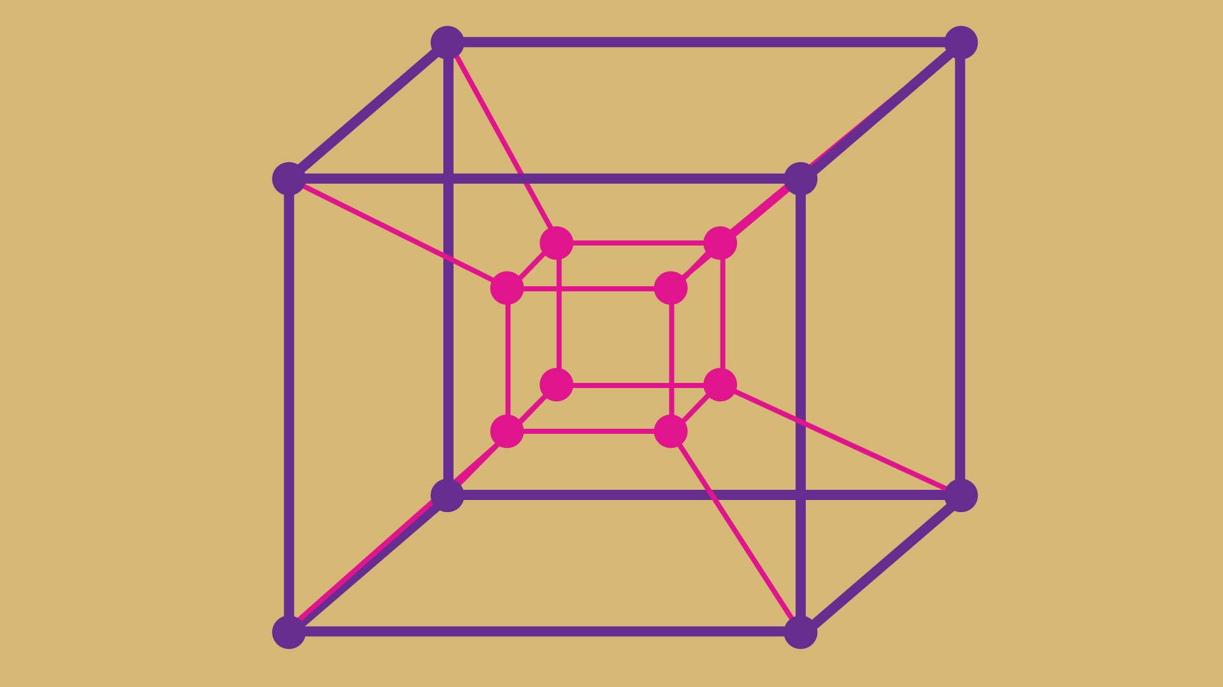
Multidimensional Growth!
They are all related to one another

Slide 12
Multidimensional Growth!
Towards becoming a scientist
Towards becoming a coder
Towards becoming a physiologist

Slide 13
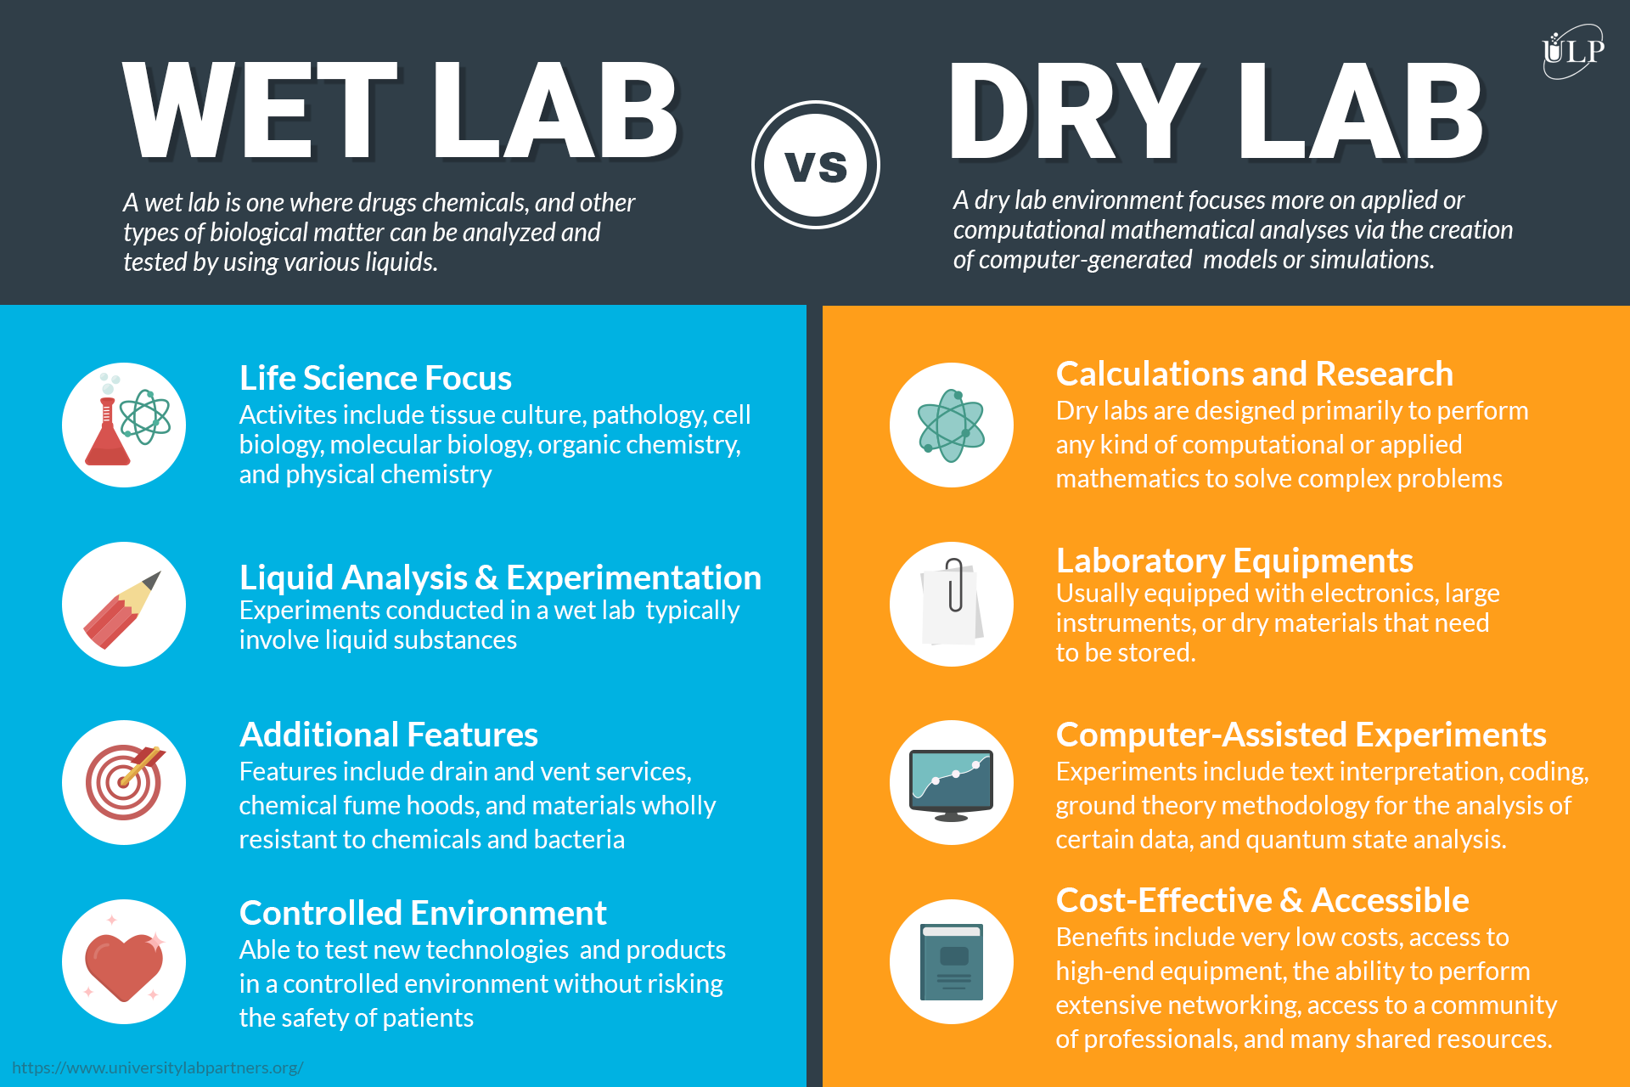
Wet and Dry Science

Slide 15
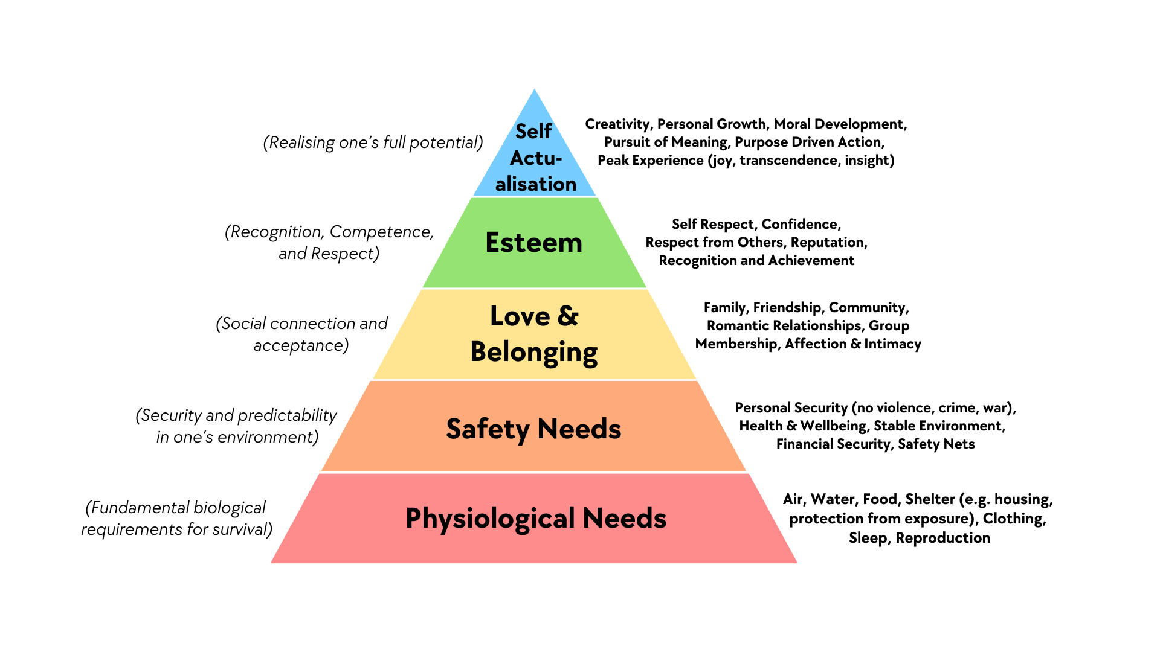

Slide 16

The World is Your Resource

Slide 17
Nelson Lab Team!

Slide 18
ChatGPT
Crutch or an Asset?

Slide 19
The Project: Deliverable

Slide 20
Manuscript Outline

Slide 21
Outlining Expectations
1. Scientific and Technical Learning Goals
2. Computational Skill Development
3. Professional Conduct
4. Deliverables
5. Attitude and Growth

Slide 22
1. Scientific and Technical Learning Goals
Grasp the fundamentals of snRNA-seq: Understand what single-nucleus RNA sequencing entails, its application in kidney tissue analysis, and how it compares favorably to other omics techniques.
Acquire knowledge of kidney anatomy and cell types: Develop a solid understanding of nephron architecture and the principal cell types within the kidney to effectively analyze data.
Familiarize yourself with bioinformatics workflows: Obtain practical experience in pre-processing (such as using Cell Ranger, SoupX, Doublet Detector), conducting quality control, performing normalization, executing dimensionality reduction, clustering, and annotating data (Seurat).
Engage with literature: Read and discuss key papers related to kidney single-cell omics.

Slide 23
2. Computational Skill Development
Code reproducibility and documentation: Expect well-commented code, version control (Git/GitHub), and use of Rmarkdown, notebooks where applicable.
Tool familiarity: Learn to use tools such as dplry, Seurat (R), and visualization packages like ggplot2, plotly, or UMAP/ for exploratory analysis.
Data handling: Gain experience working with large datasets, handling sparse matrices, and managing memory issues.

Slide 24
3. Professional Conduct
Attend lab meetings and participate actively: Engage with ongoing discussions, even if outside their immediate project scope.
Weekly check-ins: Meet regularly with their me to review progress, ask questions, and set goals.
Communicate clearly: Promptly ask for help when stuck, and summarize work clearly in updates or reports.

Slide 25
4. Deliverables
Progress report or presentation: Prepare a final presentation or written report summarizing what they did, what they learned, and future directions.
Reusable scripts or notebooks: Leave behind well-documented code that others in the lab can understand and reuse.
Annotated figures or plots: Generate interpretable and high-quality plots that contribute to ongoing research or manuscript figures.
Abstract:
Manuscript:

Slide 26
5. Attitude and Growth
Curiosity encouraged: Ask questions, explore tangents within reason, and follow curiosity, especially as it connects to the main project.
Growth mindset: It's okay not to know everything up front—learning is a key goal of the internship.
Respect lab culture: Be mindful of others’ time, space, and contributions.

Slide 27
Moist Science!

Slide 28
The Dimensions
Week 1
Week 8
The Experience
BTG Classes, Discussions with Lab Members, Trying New Lab Techniques
Coding
Coding Lessons, Homework Assignments, self-directed learning
Kidney Physiology
Textbook Chapters,
Primary Research
Research Articles Journal Clubs
Deliverables
Writing Manuscript, Writing Abstract, Creating Poster

Slide 29
My Hopeful Outcomes
1) Understand basics of kidney physiology
Cell Types,
2) Introduction to Coding
Github, R, Dplyr, Seurat, troubleshooting, creativity
3) Engage with the Primary Literature

Slide 30
Every Week
Learning to Code
Learning about the Kidney
Engaging with the Primary Literature
Journal Club Presentation
Project Deliverables

Slide 31
Rough Schedule
Monday
BTG Didactics
Tuesday
1 Hour meeting with Jonathan to talk goals/progress
Finalize Checklists for the week
Lecture on Coding Lesson
Wednesday
Journal Club Presentations
Thursday
1 Hour meeting with Jonathan to talk successes and struggles
Friday
Renal Physiology Quiz

